Slide 1
HTML and CSS Box Model
Presentation by: Yan Mahdi Saranta

Slide 2
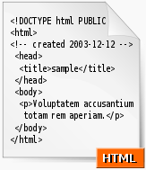
CSS Box Model
Definition
CSS box model is essentially a box that wraps around HTML elements, and it consists of: margins, borders, padding, and the actual content.

Slide 3
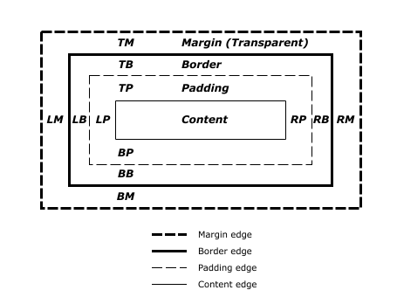
CSS Box Model

Slide 4
CSS Box Model
#myBox {
margin: 10px;
padding: 5px;
width: 70px;
}
Notes:
Frames
With frames, you can display more than one HTML document in the same browser window. Each HTML document is called a frame, and each frame is independent of the others.
The Frameset Tag
defines how to divide the window into frames

Slide 5
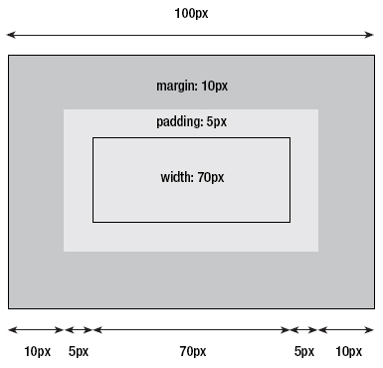
CSS Box Model
Notes:
Frames
With frames, you can display more than one HTML document in the same browser window. Each HTML document is called a frame, and each frame is independent of the others.
The Frameset Tag
defines how to divide the window into frames

Slide 6
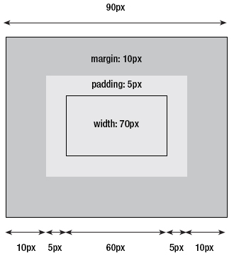
CSS Box Model (IE 6)
Notes:
Frames
With frames, you can display more than one HTML document in the same browser window. Each HTML document is called a frame, and each frame is independent of the others.
The Frameset Tag
defines how to divide the window into frames

Slide 7
CSS Box Model
Positioning
Relative Positioning Count from the position it supposed to be.
Absolute Positioning Count from positioned in relation to its nearest positioned ancestor.
Fixed Positioning Fixed position by screen.

Slide 8
CSS Box Model
#myBox {
position: relative/absolute;
left: 20px;
top: 20px;
}

Slide 9
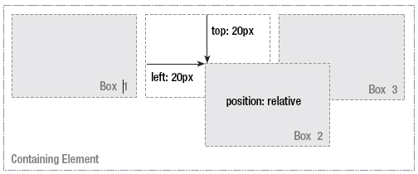
CSS Box Model (Relative)

Slide 10
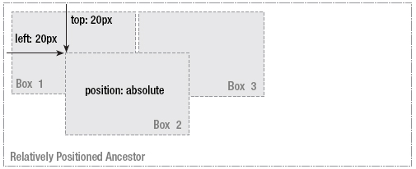
CSS Box Model (Absolute)

Slide 11
CSS Box Model
Floating A floated box can either be shifted to the left or the right until its outer edge touches the edge of its containing box, or another floated box.

Slide 12
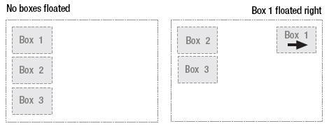
CSS Box Model
Notes:
https://plnkr.co/edit/ZuJbuXg1mKTunbyluQRp?p=preview

Slide 13
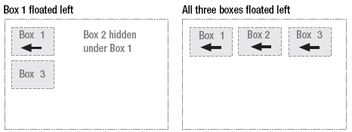
CSS Box Model

Slide 14
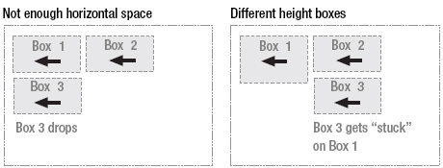
CSS Box Model
Notes:
Demo: css-boxmodel

Slide 15
Box sizing
original Internet Explorer box model represents a better, more logical approach
whose dimensions always refer to the box itself, including potential padding
We can use box-sizing: border-box; to achieve the same effect as old IE box model
Popular framework like bootstrap uses it
Notes:
https://en.wikipedia.org/wiki/Internet_Explorer_box_model_bug
https://css-tricks.com/box-sizing/

